Slide 1
Data Mining
Model Overfitting
Introduction to Data Mining, 2nd Edition
by
Tan, Steinbach, Karpatne, Kumar

Slide 2
Introduction
Algorithms learn from data.
They find relationships, develop understanding, make decisions, and evaluate their confidence from the training data they’re given.
And the better the training data is, the better the model performs.
In fact, the quality and quantity of your training data has as much to do with the success of your data project as the algorithms themselves.

Slide 3
Introduction
What is training data?
Simply put, training data is used to train an algorithm. Generally, training data is a certain percentage of an overall dataset along with testing set. As a rule, the better the training data, the better the algorithm or classifier performs.
What is a test set?
Once a model is trained on a training set, it’s usually evaluated on a test set. Oftentimes, these sets are taken from the same overall dataset, though the training set should be labeled or enriched to increase an algorithm’s confidence and accuracy.

Slide 4
Introduction
How much training data is enough?
There’s really no hard-and-fast rule around how much data you need. Different use cases, after all, will require different amounts of data. Ones where you need your model to be incredibly confident (like self-driving cars) will require vast amounts of data, whereas a fairly narrow sentiment model that’s based off text necessitates far less data. As a general rule of thumb though, you’ll need more data than you’re assuming you will.

Slide 5
Classification Errors
Training errors (apparent errors)
Errors committed on the training set
Test errors
Errors committed on the test set
Generalization errors
Expected error of a model over random selection of records from same distribution

Slide 6
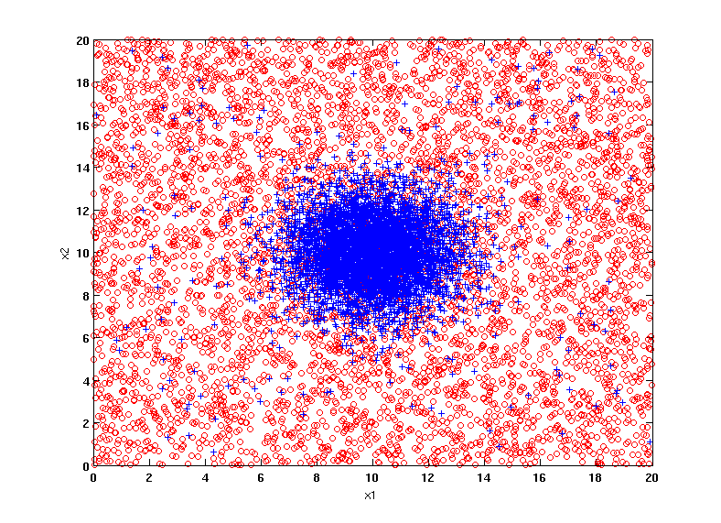
Example Data Set
Two class problem:
+ : 5200 instances
5000 instances generated from a Gaussian centered at (10,10)
200 noisy instances added
o : 5200 instances
Generated from a uniform distribution
10% of the data used for training and 90% of the data used for testing

Slide 7
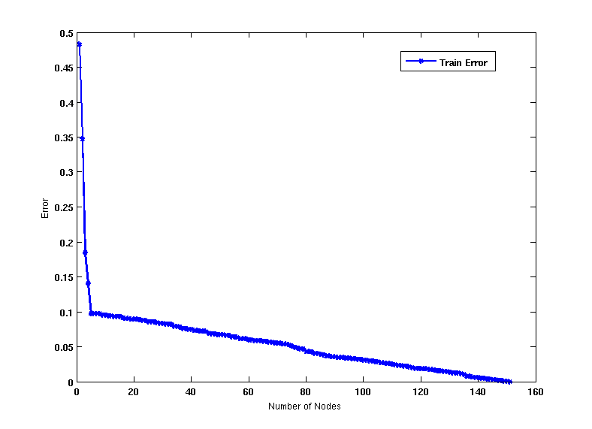
Increasing number of nodes in Decision Trees

Slide 8
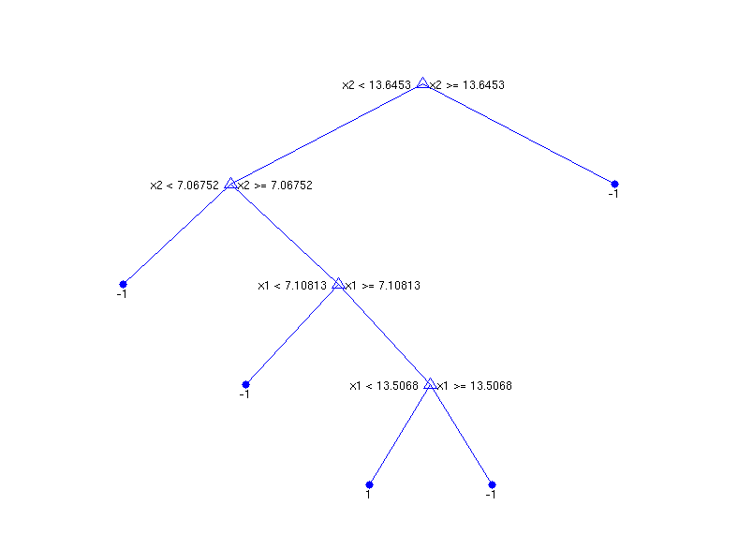
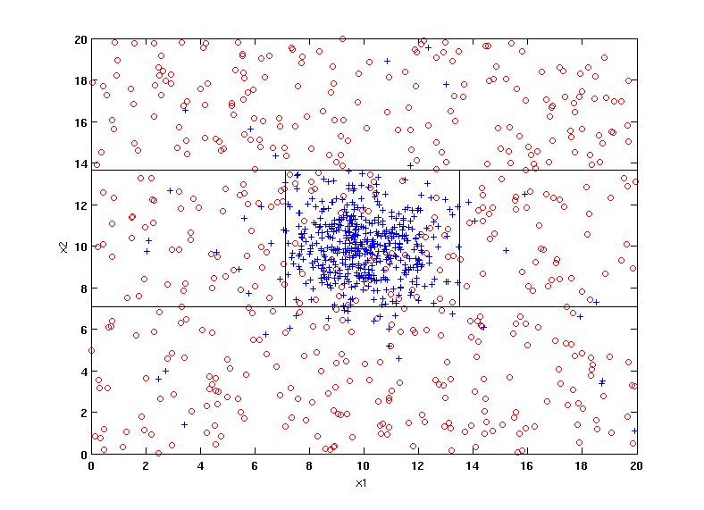
Decision Tree with 4 nodes
Decision Tree
Decision boundaries on Training data

Slide 9
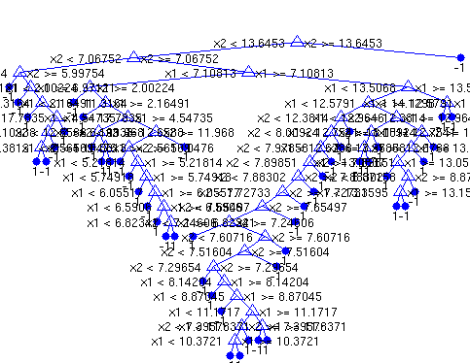
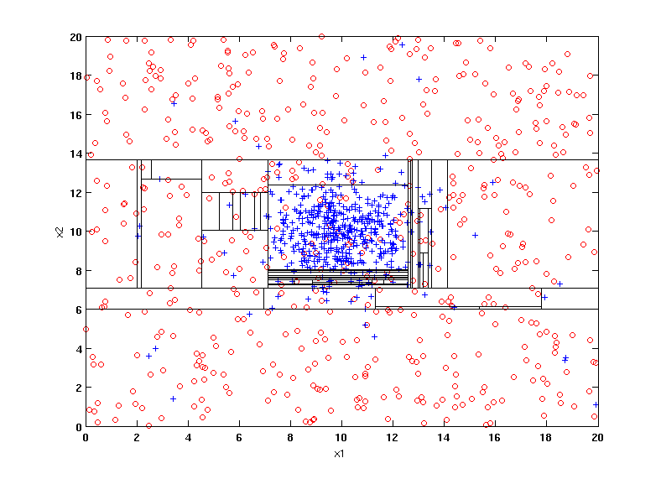
Decision Tree with 50 nodes
Decision Tree
Decision Tree
Decision boundaries on Training data

Slide 10
Which tree is better?
Decision Tree with 4 nodes
Which tree is better ?
Decision Tree with 50 nodes

Slide 11
Underfitting, Overfitting and Good Fitting
Underfitting: It refers to a model that can neither model the training data nor generalize to new data.
An underfit machine learning model is not a suitable model and will be obvious as it will have poor performance on the training data.
Overfitting: It refers to a model that models the training data too well.
Overfitting happens when a model learns the detail and noise in the training data to the extent that it negatively impacts the performance of the model on new data. For example, decision trees are a nonparametric machine learning algorithm that is very flexible and is subject to overfitting training data. This problem can be addressed by pruning a tree after it has learned in order to remove some of the detail it has picked up.
A Good Fit: You want to select a model at the sweet spot between underfitting and overfitting.
This is the goal, but is very difficult to do in practice.
We can plot both the skill on the training data and the skill on a test dataset we have held back from the training process.
Notes:
https://machinelearningmastery.com/overfitting-and-underfitting-with-machine-learning-algorithms/

Slide 12
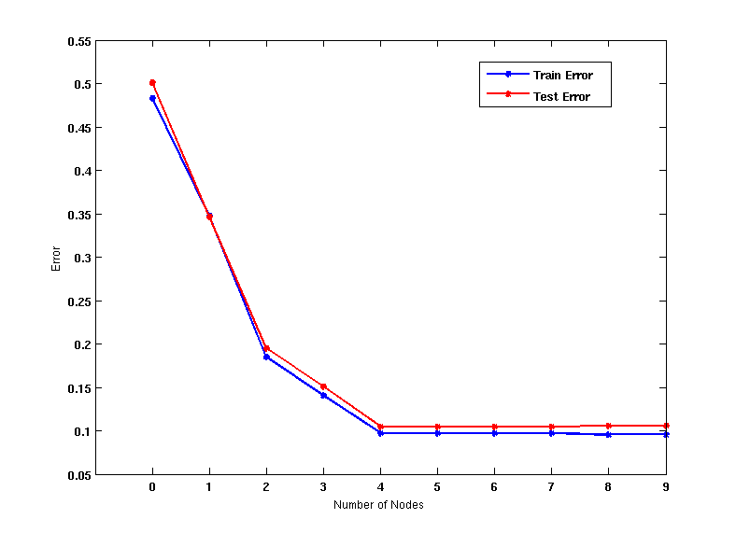
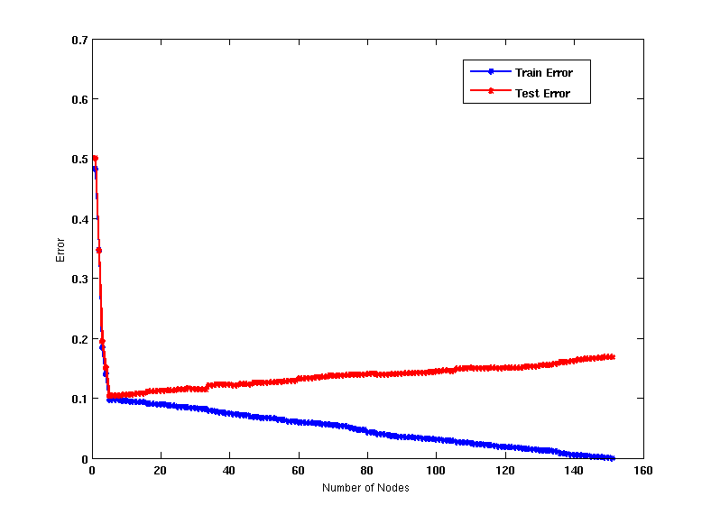
Model Overfitting
Underfitting
Overfitting
Underfitting: when model is too simple, both training and test errors are large
Overfitting: when model is too complex, training error is small but test error is large

Slide 13
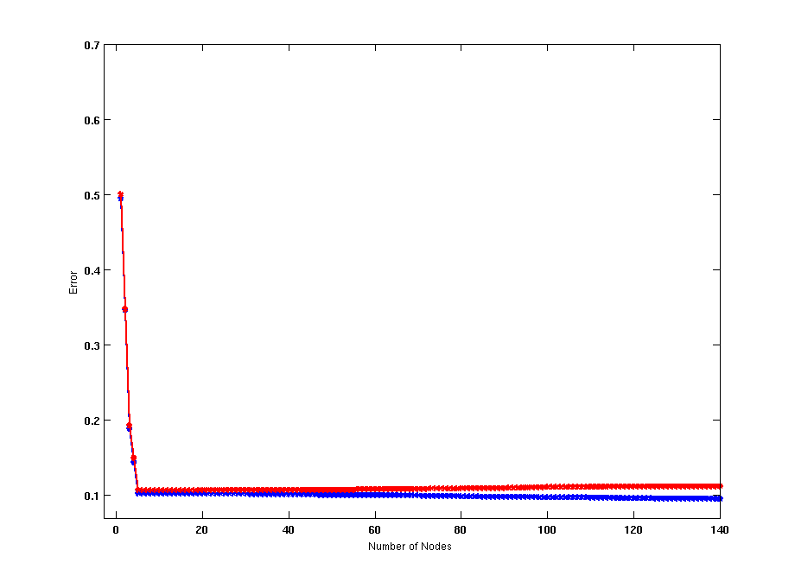
Model Overfitting
Using twice the number of data instances
If training data is under-representative, testing errors increase and training errors decrease on increasing number of nodes
Increasing the size of training data reduces the difference between training and testing errors at a given number of nodes

Slide 14
Reasons for Model Overfitting
Limited Training Size
High Model Complexity
Multiple Comparison Procedure

Slide 15
Effect of Multiple Comparison Procedure
Consider the task of predicting whether stock market will rise/ fall in the next 10 trading days
Random guessing:
P(correct) = 0.5
Make 10 random guesses in a row:
Day 1 | Up
Day 2 | Down
Day 3 | Down
Day 4 | Up
Day 5 | Down
Day 6 | Down
Day 7 | Up
Day 8 | Up
Day 9 | Up
Day 10 | Down
Notes:
(10, 8) = 10 * 9 * 8! / (8! * 2!) = 45
(10, 9) = 10 * 9! / (9!) = 10
(10, 10) = 10! / (10! * 0!) = 1
Total = 45 + 10 + 1 = 56
P(#correct >= 8) = 56/1024 = 0.0546

Slide 16
Effect of Multiple Comparison Procedure
Approach:
Get 50 analysts
Each analyst makes 10 random guesses
Choose the analyst that makes the most number of correct predictions
Probability that at least one analyst makes at least 8 correct predictions

Slide 17
Effect of Multiple Comparison Procedure
Many algorithms employ the following greedy strategy:
Initial model: M
Alternative model: M’ = M ∪ γ, where γ is a component to be added to the model (e.g., a test condition of a decision tree)
Keep M’ if improvement, Δ(M,M’) > α
Often times, γ is chosen from a set of alternative components, Γ = {γ₁, γ₂, …, γ_{k}}
If many alternatives are available, one may inadvertently add irrelevant components to the model, resulting in model overfitting

Slide 18
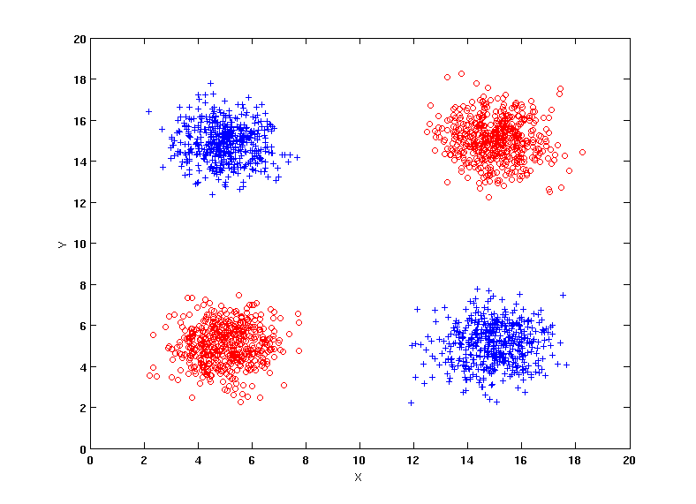
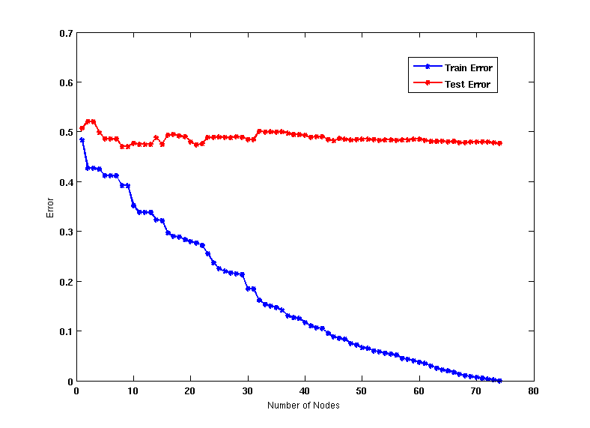
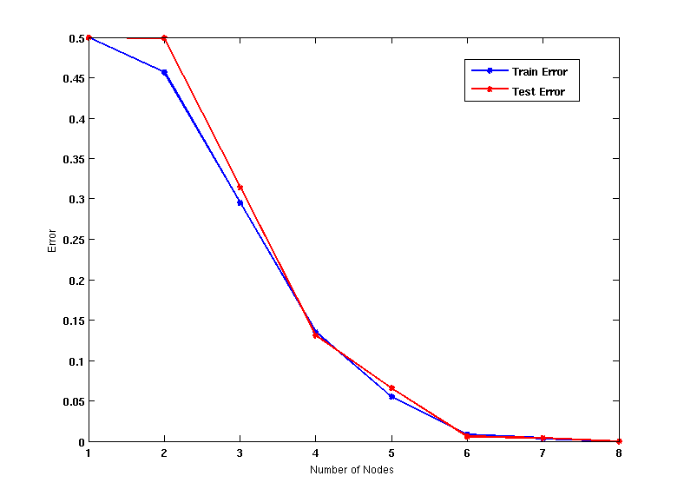
Effect of Multiple Comparison - Example
Use additional 100 noisy variables generated from a uniform distribution along with X and Y as attributes.
Use 30% of the data for training and 70% of the data for testing
Using only X and Y as attributes
Notes:
Discuss uniform distribution using Internet Wikipedia.
In probability theory and statistics, the continuous uniform distribution or rectangular distribution is a family of symmetric probability distributions such that for each member of the family, all intervals of the same length on the distribution's support are equally probable.

Slide 19
Notes on Overfitting
Overfitting results in decision trees that are more complex than necessary
Training error does not provide a good estimate of how well the tree will perform on previously unseen records
Need ways for estimating generalization errors

Slide 20
Model Selection
Performed during model building
Purpose is to ensure that the model is not overly complex (to avoid overfitting)
Need to estimate generalization error
Using Validation Set
Incorporating Model Complexity
Estimating Statistical Bounds

Slide 21
Model Selection: Using Validation Set
Divide training data into two parts:
Training set:
use for model building
Validation set:
use for estimating generalization error
Note: validation set is not the same as test set
Drawback:
Less data available for training

Slide 22
Model Selection: Incorporating Model Complexity
Rationale: Occam’s Razor
Given two models of similar generalization errors, one should prefer the simpler model over the more complex model
A complex model has a greater chance of being fitted accidentally by errors in data
Therefore, one should include model complexity when evaluating a model
Gen. Error(Model) = Train. Error(Model, Train. Data) +
x Complexity(Model)

Slide 23
Estimating the Complexity of Decision Trees
Pessimistic Error Estimate of decision tree T with k leaf nodes:
err(T): error rate on all training records
Ω: trade-off hyper-parameter (similar to )
Relative cost of adding a leaf node
k: number of leaf nodes
N_{train}: total number of training records

Slide 24
Estimating the Complexity of Decision Trees: Example
e(T_{L}) = 4/24
e(T_{R}) = 6/24
Ω = 1
e_{gen}(T_{L}) = 4/24 + 1*7/24 = 11/24 = 0.458
e_{gen}(T_{R}) = 6/24 + 1*4/24 = 10/24 = 0.417
err(T): error rate on all training records
Ω: trade-off hyper-parameter (similar to)
Relative cost of adding a leaf node
k: number of leaf nodes
N_{train}: total number of training records
Notes:
(1 + 1 + 2 + 2 + 1 + 5) / 3 = 4
e(TL) = 4/24
(2 + 4 + 0 + 6) / 2 = 6
e(TR) = 6/24
7/24 = 7 represents the outer leaves
4/24 = 4 represents the outer leaves

Slide 25
Estimating the Complexity of Decision Trees
Resubstitution Estimate:
Using training error as an optimistic estimate of generalization error
Referred to as optimistic error estimate
e(T_{L}) = 4/24
e(T_{R}) = 6/24

Slide 26
Minimum Description Length (MDL)
Cost(Model,Data) = Cost(Data|Model) + x Cost(Model)
Cost is the number of bits needed for encoding.
Search for the least costly model.
Cost(Data|Model) encodes the misclassification errors.
Cost(Model) uses node encoding (number of children) plus splitting condition encoding.

Slide 27
Estimating Statistical Bounds
Before splitting: e = 2/7 = 0.286, e’(7, 2/7, 0.25) = 0.527 e’(T) = 7 × 0.527 = 3.689
After splitting: e(T_{L}) = 1/4, e’(4, 1/4, 0.25) = 0.537 e(T_{R}) = 1/3, e’(3, 1/3, 0.25) = 0.650 e’(T) = 4 × 0.537 + 3 × 0.650 = 4.098
Therefore, do not split
Notes:
http://simulation-math.com/_Statistics/FindZalphaover2.cshtml
Zalpha = 1.28
A1 = 0.286 * (1 - 0.286) / 7 = 0.029172
A2 = 1.28 * 1.28 / (4 * 7 * 7) = 0.008
A = sqrt (A1 + A2) = sqrt(0.0375) = 0.193
Denominator = (1 + 1.28 * 1.28 /7) = 1.234
Result = (0.286 + (1.28*1.28)/(2*7)+1.28*A) / Denominator
= (0.403 + 1.28 * A) / Denominator
= (0.403 + 0.247) / 1.234
= 0.527
A1 = 0.286 * (1 - 0.286) / 7 = 0.029172
A2 = 1.16 * 1.16 / (4 * 7 * 7) = 0.006
A = sqrt (A1 + A2) = sqrt(0.0375) = 0.189
Denominator = (1 + 1.16 * 1.16 /7) = 1.192
Result = (0.286 + (1.16*1.16)/(2*7)+1.16*A) / Denominator
= (0.382 + 1.16 * A) / Denominator
= (0.403 + 0.219) / 1.192
e’(7, 2/7, 0.25) = 0.521

Slide 28
Model Selection for Decision Trees
Pre-Pruning (Early Stopping Rule)
Stop the algorithm before it becomes a fully-grown tree
Typical stopping conditions for a node:
Stop if all instances belong to the same class
Stop if all the attribute values are the same
More restrictive conditions:
Stop if number of instances is less than some user-specified threshold
Stop if the class distribution of instances are independent of the available features (e.g., using χ ² test)
Stop if expanding the current node does not improve impurity measures (e.g., Gini or information gain).
Stop if estimated generalization error falls below certain threshold
Notes:
A chi-squared test, also written as χ² test, is any statistical hypothesis test where the sampling distribution of the test statistic is a chi-squared distribution when the null hypothesis is true.
In inferential statistics, the term "null hypothesis" is a general statement or default position that there is no relationship between two measured phenomena, or no association among groups. Rejecting or disproving the null hypothesis—and thus concluding that there are grounds for believing that there is a relationship between two phenomena

Slide 29
Model Selection for Decision Trees
Post-pruning
Grow decision tree to its entirety
Subtree replacement
Trim the nodes of the decision tree in a bottom-up fashion
If generalization error improves after trimming, replace sub-tree by a leaf node
Class label of leaf node is determined from majority class of instances in the sub-tree
Subtree raising
Replace subtree with most frequently used branch

Slide 30
Example of Post-Pruning
Training Error (Before splitting) = 10/30 = 0.3
Pessimistic error = 10/30 + 0.5 * 10/30 = 10.5/30 = 0.35
Training Error (After splitting)
= 4/12 + 4/7 + 1/5 + 1/6 = 0.31
Pessimistic error (After splitting)
= 0.31 + 0.5 * (4 + 4 + 1 + 1) / 30 = 0.46
PRUNE!
Class = Yes | 20
Class = No | 10
Error = 10/30
If the penalty is 0.5
Class = Yes | 8
Class = No | 4
Class = Yes | 3
Class = No | 4
Class = Yes | 4
Class = No | 1
Class = Yes | 5
Class = No | 1
Notes:
4/12 + 4/7 + 1/5 + 1/6 = (4/12+1/6) + (4/7 + 1/5) = 6/12 + 27/35 = (210+ 324)/420 = 534/420 * ¼ = 0.31

Slide 31
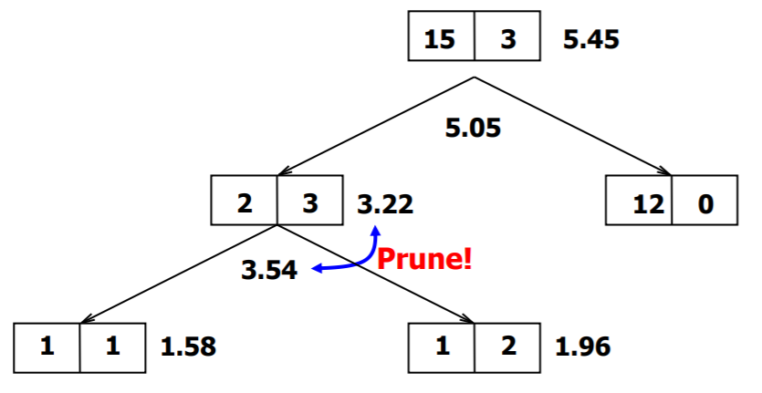
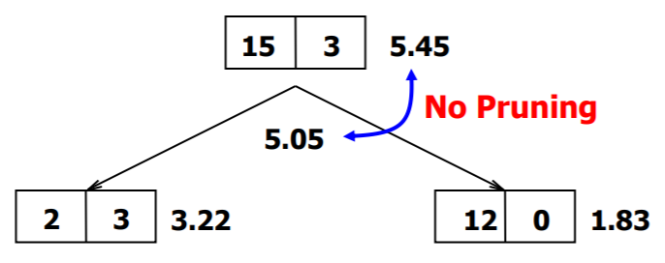
Do We need Pruning or Not?
Pessimistic Error

Slide 32
Model Evaluation
Purpose:
To estimate performance of classifier on previously unseen data (test set)
Holdout
Reserve k% for training and (100 - k)% for testing
Random subsampling: repeated holdout
Cross validation
Partition data into k disjoint subsets
k-fold: train on k - 1 partitions, test on the remaining one
Leave-one-out: k = n
Notes:
Random Subsampling
Random sub­sampling, which is also known as Monte Carlo crossvalidation, as multiple holdout or as repeated evaluation set, is based on randomly splitting the data into subsets, whereby the size of the subsets is defined by the user. The random partitioning of the data can be repeated arbitrarily often. In contrast to a full crossvalidation procedure, random subsampling has been shown to be asymptotically consistent resulting in more pessimistic predictions of the test data compared with crossvalidation. The predictions of the test data give a realistic estimation of the predictions of external validation data.

Slide 33
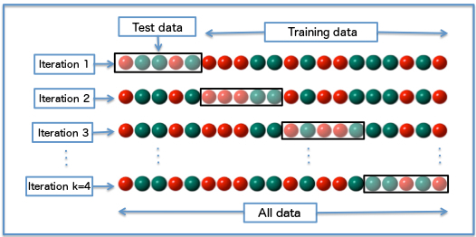
Cross-validation Example
3-fold cross-validation
Cross-validation, sometimes called rotation estimation, is a model validation technique for assessing how the results of a statistical analysis will generalize to an independent data set. It is mainly used in settings where the goal is prediction, and one wants to estimate how accurately a predictive model will perform in practice.

Slide 34
Summary
Introduction
Classification Errors
Decision tree with 4 and 50 nodes
Underfitting, Overfitting and Good fitting
Model Overfittting
Effect of Multiple comparison
Model Selection
Estimating the complexity of decision trees
Estimating statistical bounds
Model evaluation

